Slide 1
AIRLINE TICKET FARE PREDICTION by team 8 Under the guidance of Professor: DR. ARDIANA SULA Course DSCI-6007-02 DISTRIBUTED AND SCALABLE DATA ENGINEERING

Slide 2




Meet my team
Sushma Sindhe
Team Lead
Harshitha Vejella
Data Visualization
Phanideepak Gaddam
Data Collection and Preprocessing
Lakshmi Sai Kishore Savarapu
Storytelling and Data Scientist

Slide 3
objectives
Introduction
Challenge
Solution
User Story
CRISP-DM Graphical View
CRISP-DM Implementation
Business Understanding
Data Understanding
Data Preparation
Model Building
Model Evaluation
Model Deployment
Summary
Future Scope
References

Slide 4
Introduction
The Airline industry is a significant component of the global travel and transportation sector. It encompasses the buying and selling of airline tickets for passenger travel, both domestic and international. Travelers look for best deals and the Airlines try to make profit by selling their tickets. As the industry evolves, building a flight ticket fare prediction model will be a valuable tool for travelers and the airline industry. These models can benefit both consumers looking for the best deals and airlines striving to optimize their pricing strategies.

Slide 5
challenge
How to predict the price of an Airline ticket based on certain features?
Airline ticket prices are influenced by a multitude of factors, making them a complex and dynamic pricing challenge. However, with the power of data and machine learning, we can create models that provide accurate fare predictions. As the industry evolves, these models can adapt to changing market dynamics, ultimately benefiting both consumers and airlines.

Slide 6
solution
Data science and machine learning have a wide range of applications across various domains and industries. These technologies have the potential to extract valuable insights, make predictions, and automate tasks, leading to improved decision-making and efficiency. Predicting airline ticket fares is a complex task that involves multiple variables and factors. Data Science and Machine learning techniques can be used to build an effective solution for predicting airline ticket fares.

Slide 7
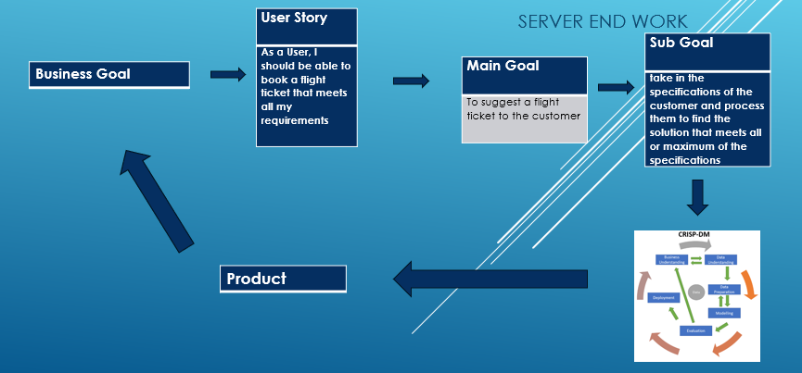
USER STORY

Slide 8
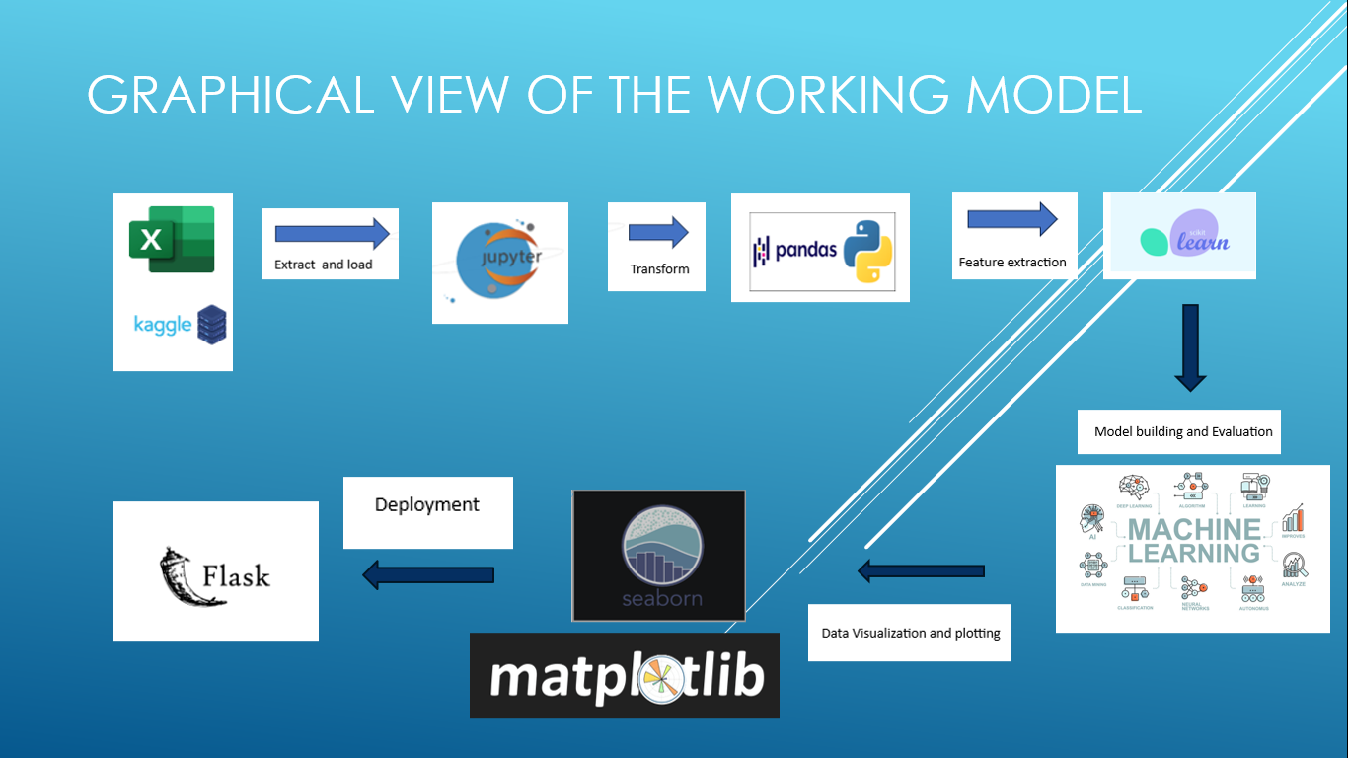
CRISP DM IMPLEMENTATION GRAPHICAL VIEW

Slide 9
CROSS INDUSTRY STANDARD PROCESS Implementation BUSINESS UNDERSTANDING
1. Business Understanding
Primary goal: Predict the Price of an Airline ticket based on given inputs such as source, destination, arrival time, departure time, duration of journey etc.
Stakeholder Identification: Airline companies, passengers, Travel Agencies etc.
Scope and Constraints: The data is generated before the pandemic i.e., 2019. And the sources and destinations are confined to cities in the country India.
Business Questions:
Which Airline company flight tickets are expensive? And which company has the cheapest?
Which location is the most frequent origin and which is the most frequent destination?
Which is the busiest route?

Slide 10
CROSS INDUSTRY STANDARD PROCESS Implementation DATA UNDERSTANDING
2. Data Understanding
Dataset: https://www.kaggle.com/datasets/nikhilmittal/flight-fare-prediction-mh
5 V’s of Data are checked to ensure right set of data is collected for the problem statement.
Volume: 10683 samples of data.
Variety: Structured Data.
Velocity: Data generated during the pre-covid period.
Veracity: Kaggle is said to be the trusted go to point of information.
Value: Data can be used to estimate domestic flight fares in India.

Slide 11
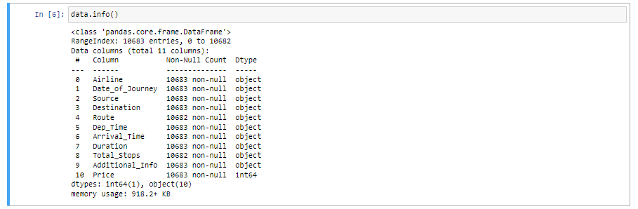
CROSS INDUSTRY STANDARD PROCESS Implementation DATA UNDERSTANDING
data.info() function in python is used to retrieve information about the data.

Slide 12
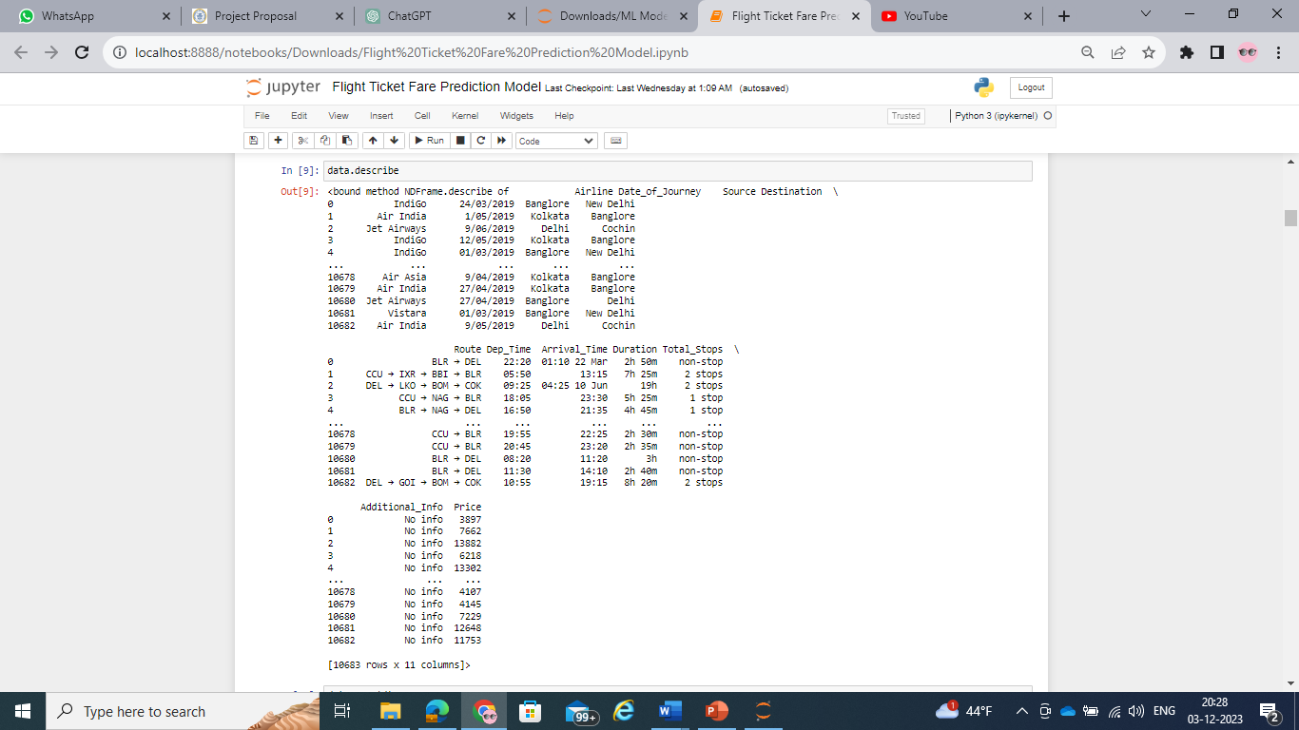
CROSS INDUSTRY STANDARD PROCESS Implementation DATA UNDERSTANDING
The data.describe function in python is used to generate descriptive statistics of a dataframe.

Slide 13
CROSS INDUSTRY STANDARD PROCESS Implementation DATA PREPARATION
3. Data Preparation
Also known as Data Preprocessing.
Involves transforming raw data into a clean, organized format that is suitable for analysis or modeling. It involves the following steps:
Handling missing values
Label encoding categorical variables
Feature engineering
Data transformation
Filtering of data
Train test splitting of data

Slide 14
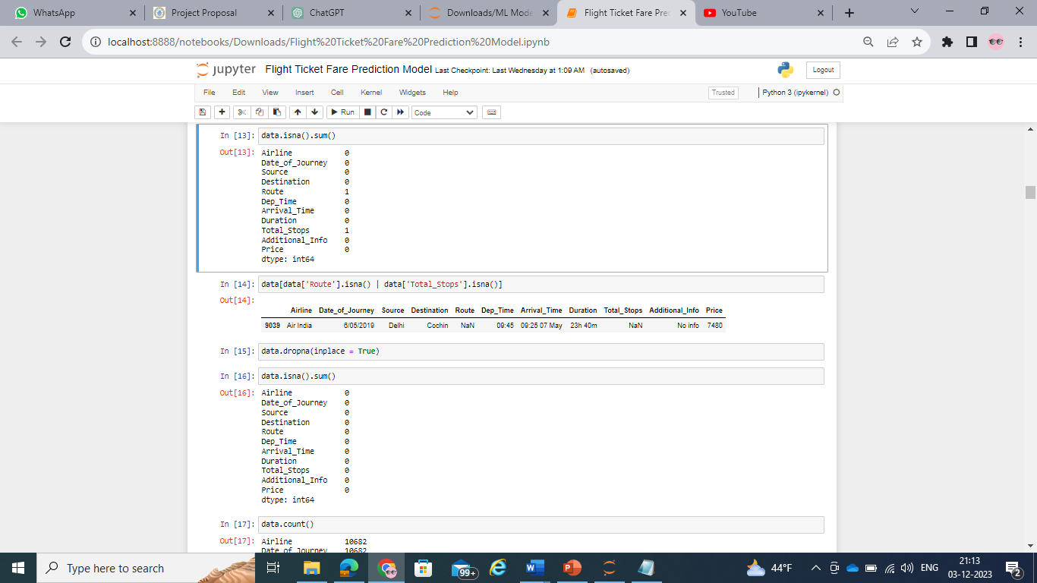
CROSS INDUSTRY STANDARD PROCESS Implementation DATA PREPARATION
3. Data Preparation
Handling missing values

Slide 15
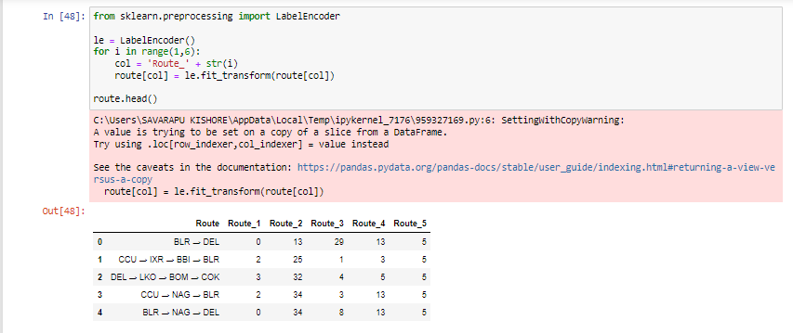
CROSS INDUSTRY STANDARD PROCESS Implementation DATA PREPARATION
3. Data Preparation
Label encoding categorical variables

Slide 16
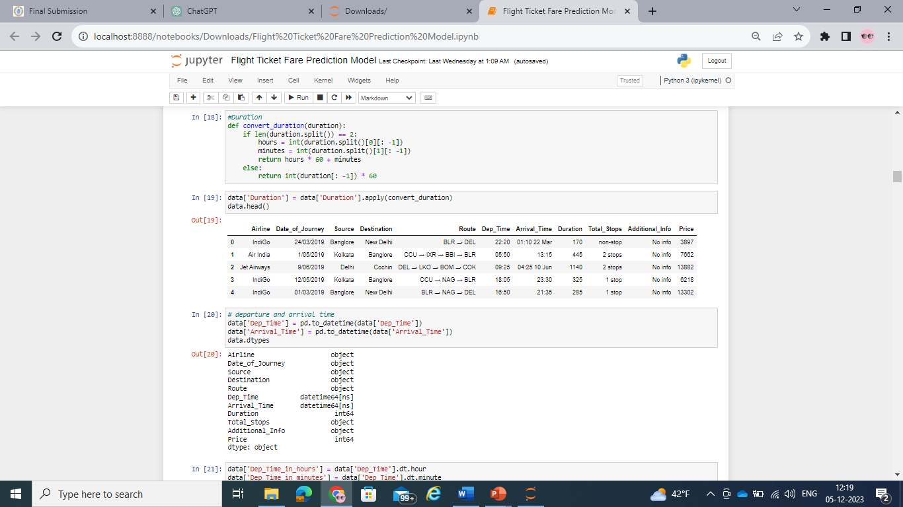
CROSS INDUSTRY STANDARD PROCESS Implementation DATA PREPARATION
3. Data Preparation
Feature engineering

Slide 17
CROSS INDUSTRY STANDARD PROCESS Implementation DATA PREPARATION
3. Data Preparation
Data transformation

Slide 18
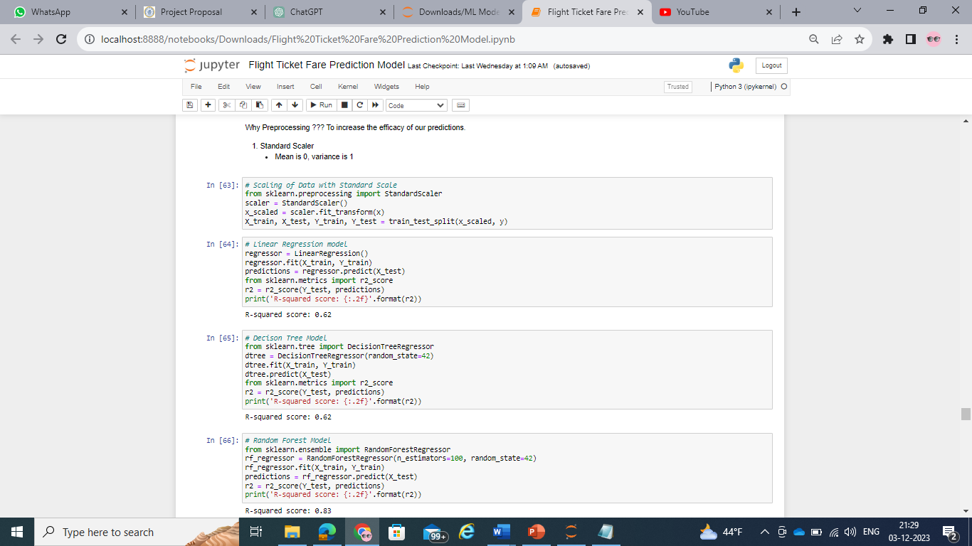
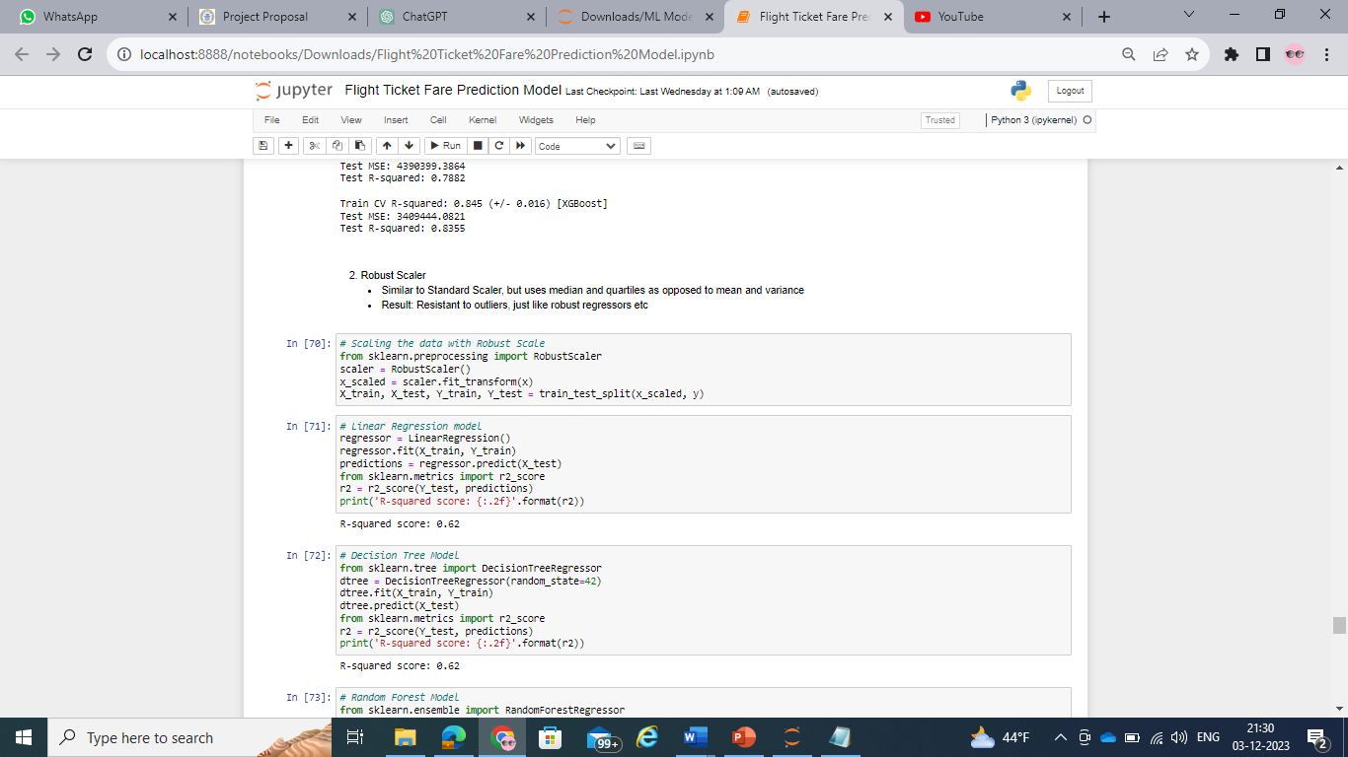
CROSS INDUSTRY STANDARD PROCESS Implementation DATA PREPARATION
3. Data Preparation
Filtering of data: Done with Standard scale and Robust scale.

Slide 19
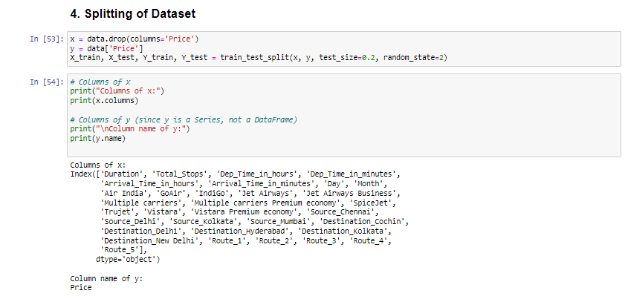
CROSS INDUSTRY STANDARD PROCESS Implementation DATA PREPARATION
3. Data Preparation
Train test splitting of data

Slide 20
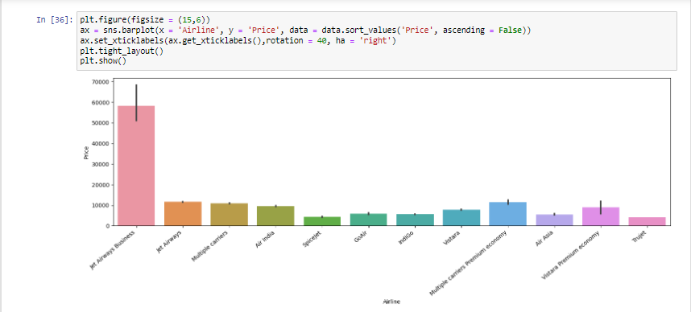
CROSS INDUSTRY STANDARD PROCESS Implementation DATA VISUALIZATION
Data Visualization
Carried out to draw underlying insights from the dataset.

Slide 21
CROSS INDUSTRY STANDARD PROCESS Implementation MODEL BUILDING
4. Model Building
Target variable: Price of Flight ticket
Type of the target variable: Continuous
Type of models that can be built: Regression models
Linear Regression model, Decision Tree model, Random Forest model, Ordinary Least Squared Model, Support Vector Regressor Model, AdaBoost Regressor Model, Bagging Regressor Model, Gradient Boost Regressor Model, XG Boost Regressor Model.

Slide 22
CROSS INDUSTRY STANDARD PROCESS Implementation MODEL evaluation
5. Model Evaluation
Explains how accurately the model is working on real and new data.
The built models are evaluated by calculating the R squared value and Mean Absolute Error.
R-squared measures how well the independent variables explain the variability of the dependent variable.
Mean Absolute Error (MAE) is a metric used to evaluate the accuracy of a predictive model, often in the context of regression analysis. It measures the average absolute difference between the actual and predicted values.

Slide 23
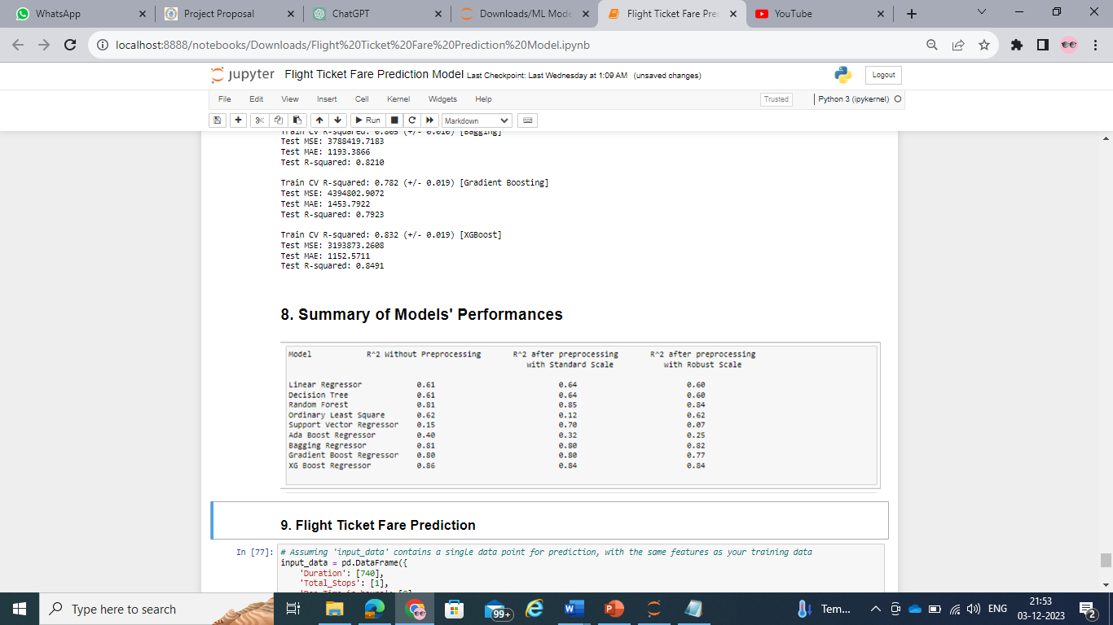
CROSS INDUSTRY STANDARD PROCESS Implementation MODEL evaluation
R squared values of the models. It ranges between 0 and 1, with:
0 indicating that the model does not explain any variance in the target variable.
1 indicating that the model perfectly explains the variance in the target variable.

Slide 24
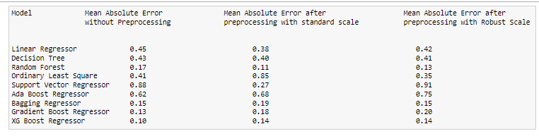
CROSS INDUSTRY STANDARD PROCESS Implementation MODEL evaluation
Mean Absolute Error (MAE) of the models. The Mean Absolute Error (MAE) values range from 0 to positive infinity. A lower MAE indicates better model performance.
The formula for calculating MAE is: MAE = (1/n) Σ(i=1 to n) |y_i – ŷ_i|
y_i = prediction, ŷ_i = True value, n = total number of data points

Slide 25
CROSS INDUSTRY STANDARD PROCESS Implementation MODEL DEPLOYMENT
6. Model Deployment
Making a model available for use in a production environment to generate predictions or perform the intended task.
Which model gave better performance during Evaluation: XG Boost Regressor Model.
So we deploy XG Boost Regressor model using Flask Web Framework.
Flask is a popular web framework in Python used for building web applications, including deploying machine learning models as web services or APIs.
After deploying the model, the address of the API is: http://10.0.0.104:8000/ where the end users can give input and get the output.

Slide 26
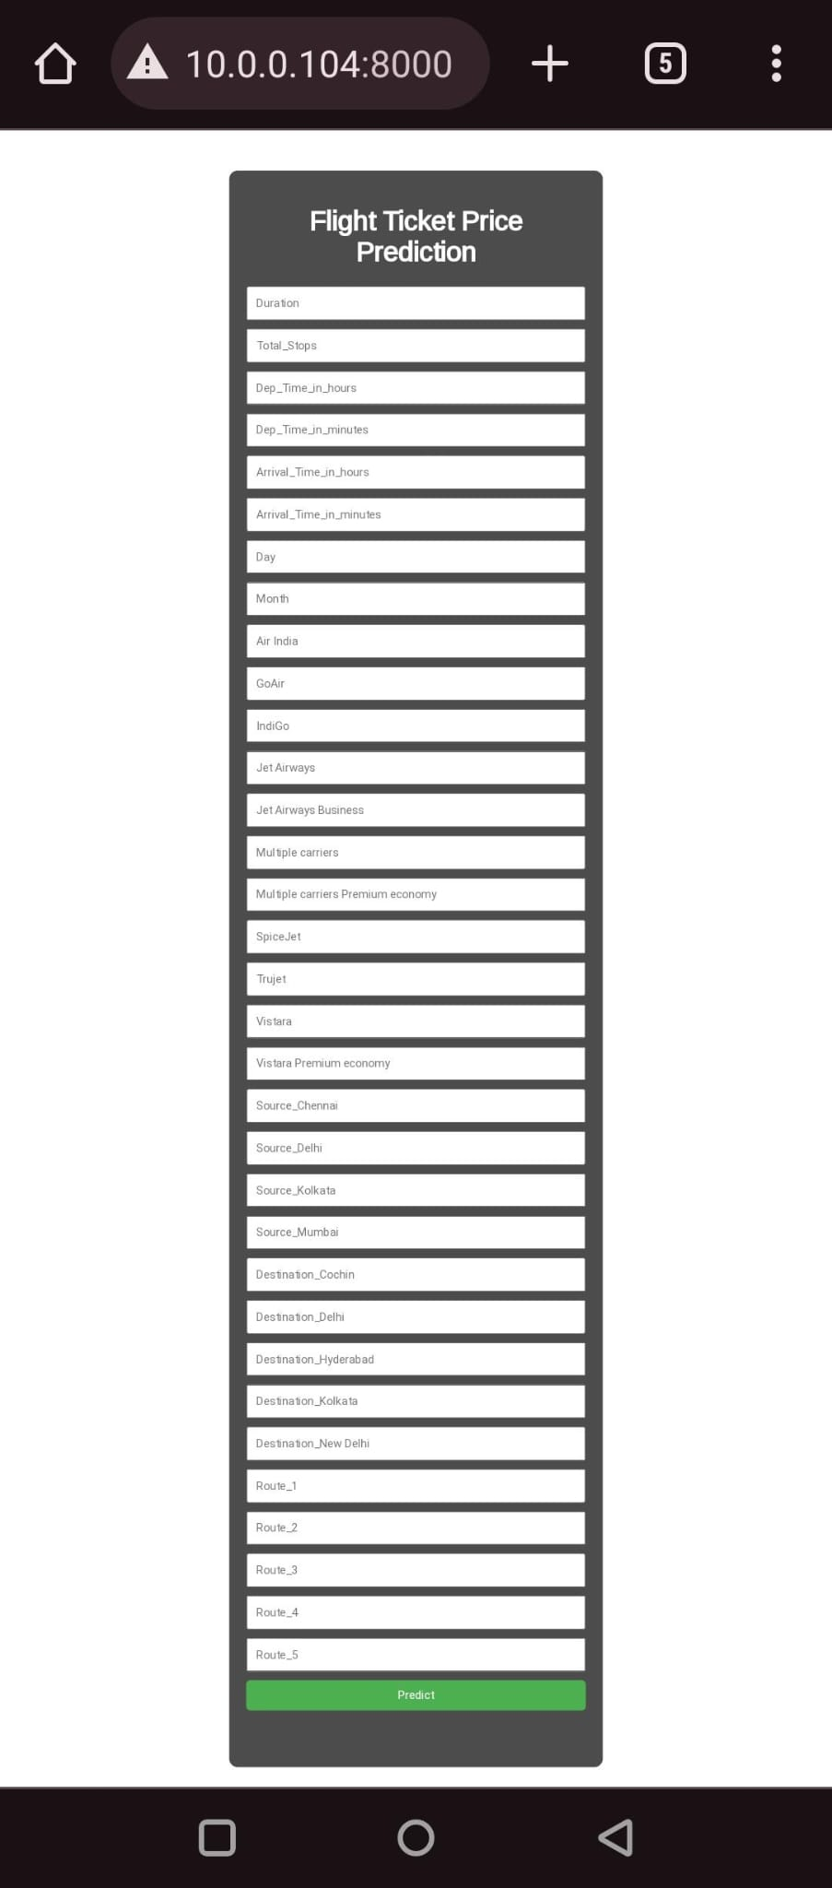
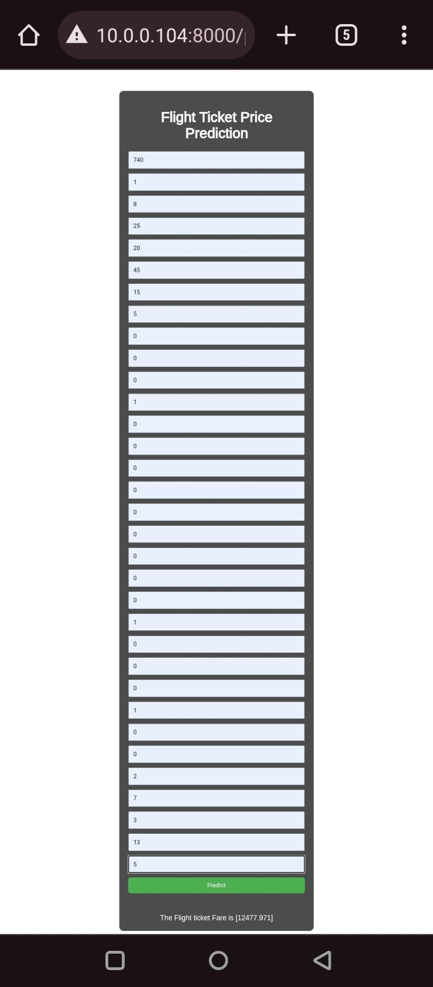
CROSS INDUSTRY STANDARD PROCESS Implementation MODEL DEPLOYMENT

Slide 27
SUMMARY
The XG Boost Machine Learning model gave better performance than the other regressor models.
After deploying the model using Flask web server, the model gave required outputs and met all the business requirements.
This model can be used to get the flight ticket price by providing the inputs to it through the flask web application.

Slide 28
Future scope
A Custom ensemble model (Super Learner) model can be built using multiple models to improve the performance of the model and get better results from it.
The model is confined to only domestic flights in India.
Models can be built to predict ticket prices for international flights so that when deployed, the model can be used by international airlines and passengers.

Slide 29
references
https://youtu.be/WjLou_0YVMo?si=O_MsRoI5q4ooTXeC
https://youtu.be/46bRwRvW0PI?si=KIchjcJvDOZkfBMq
https://youtu.be/KFPX0FLhscs?si=VSFVpvoKYssh3epv
https://www.kaggle.com/datasets/nikhilmittal/flight-fare-prediction-mh/code

Slide 30


Business time! ANY BUYERS?

Slide 31
Thank you! ANY QUESTIONS?

